Slide 1
visualization and analysis of Vancouver crime data
Zili Luo

Slide 2
Intro
Dataset
Initial preprocessing
Visualization result
Potential correlation
Predictive model
Preprocessing for predictive model
Predictive result

Slide 3
Dataset
Vancouver crime dataset
530,652 records
not that much information
9 types of crime but mostly kinds of theft
about 10% of the data is anonymous
about 1% of data is missing

Slide 4
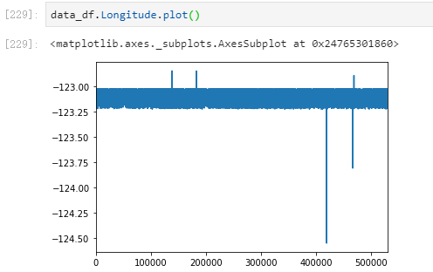
Preprocessing part.1
Drop the missing data
Drop the anamyous data
Drop the outliers

Slide 5
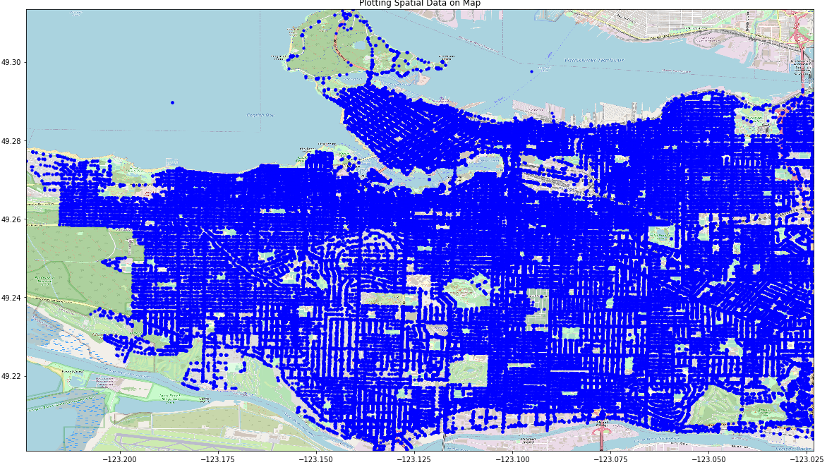
Visualize Results

Slide 6
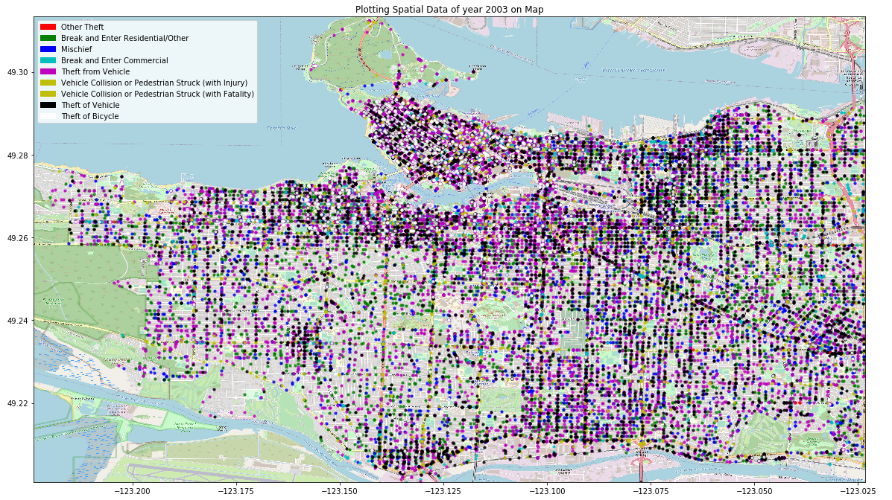
Visualize Results cont.

Slide 7
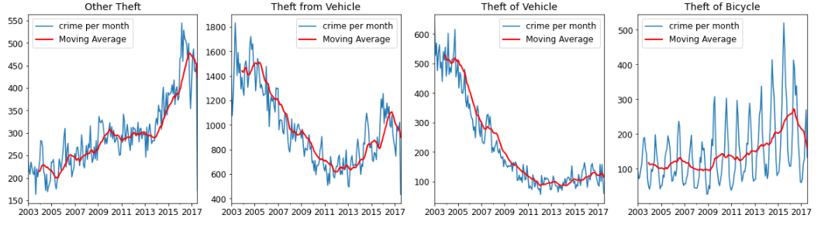
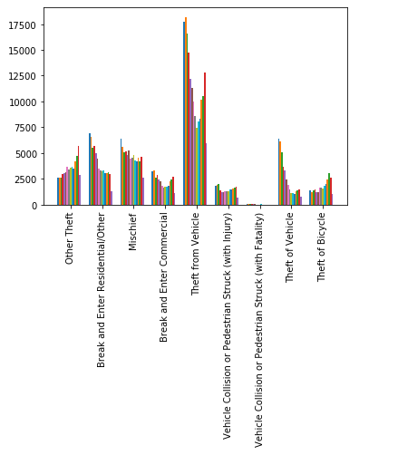
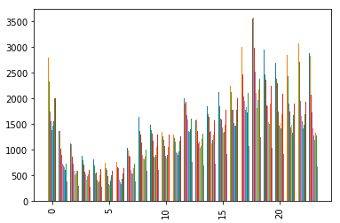
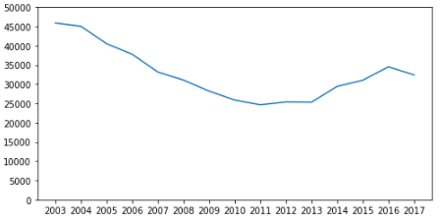
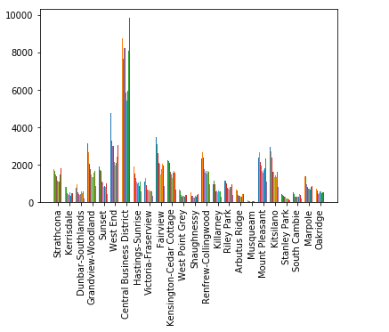
Visualize Results cont.
crimes by hour
crimes by type
crimes by
neighborhood

Slide 8
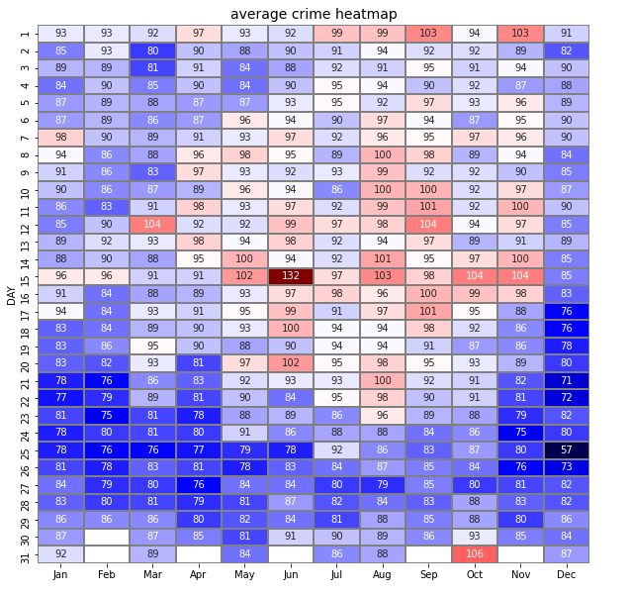
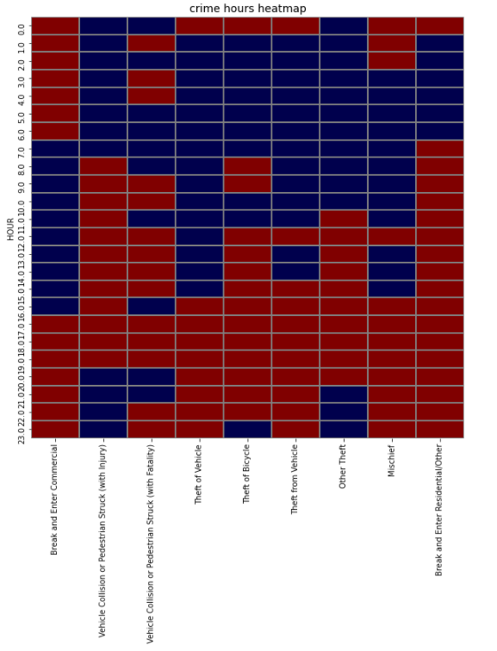
Visualize Results cont.

Slide 9
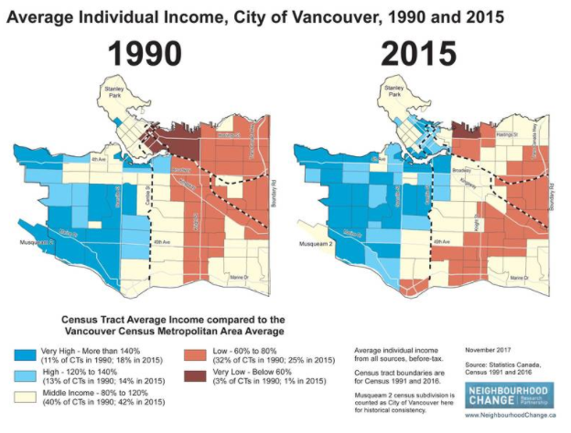
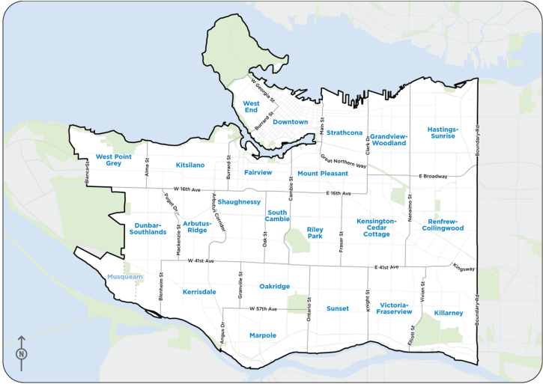
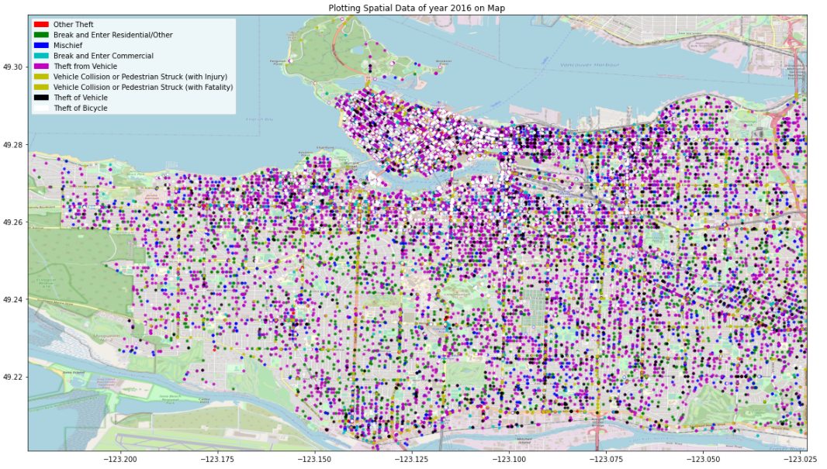
Potential relationship

Slide 10
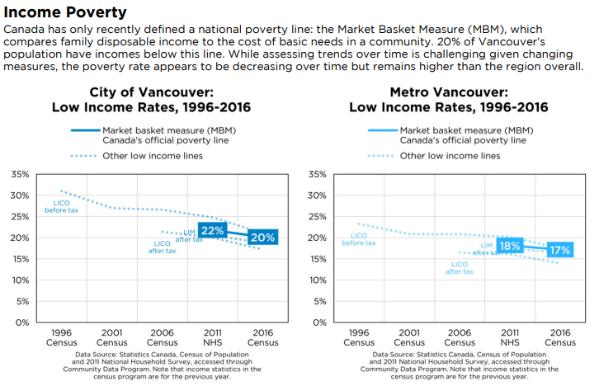
Potential relationship cont.

Slide 11
Predictive model?
From all the visualization, there would be some potential features of different crimes.
Do not expect good result before start the experiment as most data is related to theft, and the dataset is not clear enough at visualization stage.

Slide 12
Preprocessing part.2
Merage some classes
Feature selection
Ordinal to category

Slide 13
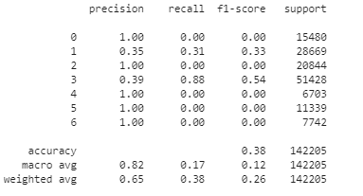
Predictve Result
Not good at all
38% accuracy during training
classified all cases into class 1
and class 3
But all in expectation

Slide 14
Reference
https://vancouver.ca/files/cov/social-indicators-profile-city-of-vancouver.pdf
https://www.kaggle.com/wosaku/crime-in-vancouver
https://dailyhive.com/vancouver/34-biggest-moments-vancouver-history
https://vpd.ca/police/about/strategic-planning/index.html

Slide 15
Thanks

